Slide 1
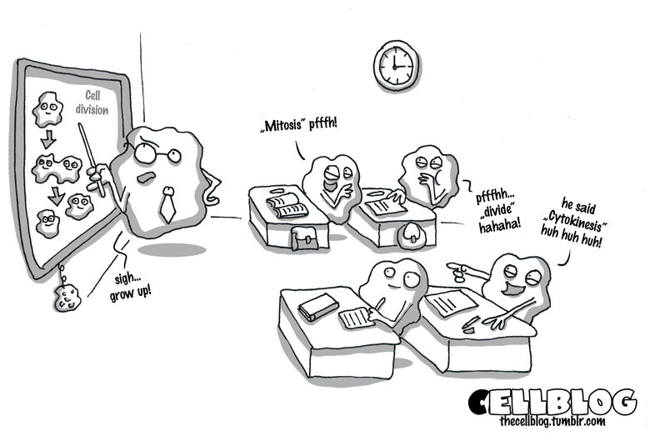
exam review
exam review
Sex Education. (Accessed 2014). Uploaded to The Cell Blog Tumblr Account. Available online at: http://www.funnyjunk.com/funny_pictures/4394464/sex+education

Slide 2
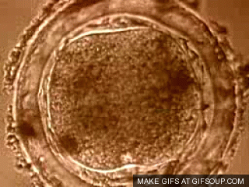
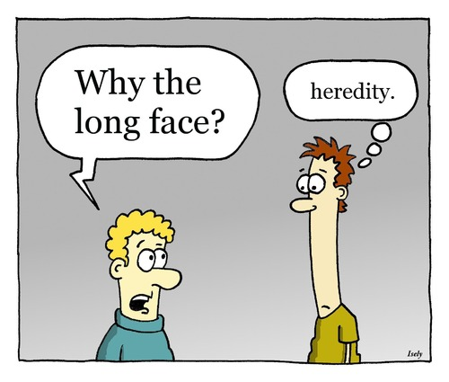
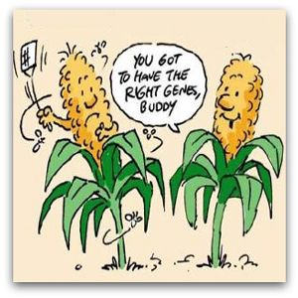
reproduction
Reproduction
We will be discussing:
Cell Division. (2011). Uploaded to GifSoup by jhelgason. Available online at: htthttps://gifsoup.com/view/2788087/cell-division.html
Long Face.(2010). Uploaded by Sardonic Salad. Available online at: http://www.toonpool.com/cartoons/long%20face_105569
Nosal’s leaky GM defense. (2010). Uploaded by Charles Rue. Available online at: http://www.eurekastreet.com.au/article.aspx?aeid=8150#.Uu7GVE24vIV

Slide 3
reproduction
Reproduction
Part 1 Breakdown
29 Points –
4 points multiple choice
9 points short answer
6 points solving punnett squares
10 points long answer response

Slide 4
reproduction
Reproduction
Heterozygous
Homozygous
Dominant
Recessive
Asexual Reproduction
Sexual Reproduction
Mitosis
Meiosis
Genotype
Phenotype
Important
Vocabulary!!

Slide 5
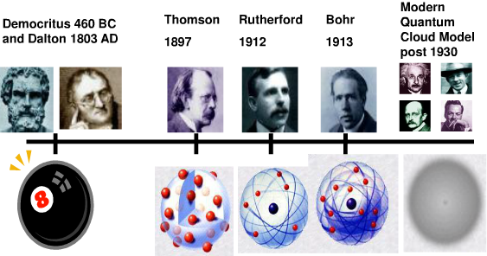
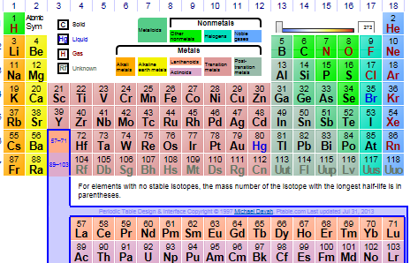
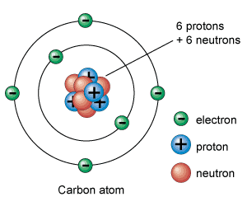
Atoms and
Elements
Atoms and
Elements
We will be discussing:
History of the Atom Timeline. (2008). Uploaded to DocStoc by Historyman. Available online at: http://www.docstoc.com/docs/2197377/History-of-the-Atom-Timeline
Interactive Periodic Table. (Accessed on 2014).
Uploaded to Ptable. Available online at: http://www.ptable.com/
Atom Model. (2010). Uploaded to by Jerry Coffee. Available online at:http://www.universetoday.com/56637/atom-model/

Slide 6
Atoms and
Elements
Atoms and
Elements
Part 2 Breakdown
31 Points –
10 points fill-in-the-blank
10 points complete a chart
11 points short answer

Slide 7
Atoms and
Elements
Atoms and
Elements
Elements 1-20
Proton, Neutron, Electron
Atomic Number
Atomic Mass
Periodic Table Organization
Molecular Compound
Ionic Compound
Bohr Diagrams
Chemical Change
Physical Change
Important
concepts!!

Slide 8
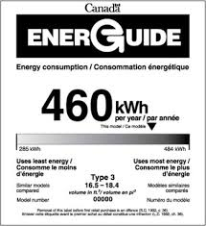
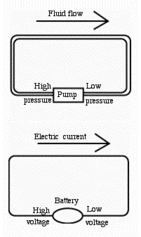
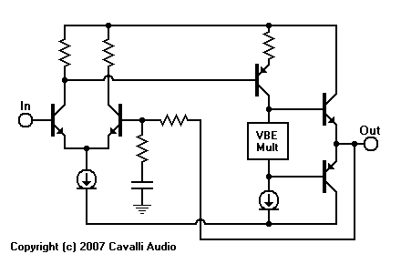
Electricity
Electricity
We will be discussing:
Electricity as a Fluid. (Accessed on 2014).
Uploaded by Dr. Dadiv Stern Available online at: http://www-spof.gsfc.nasa.gov/Education/welectrc.html
The Energuide Label (2009).
Uploaded by Natural Resources Canada. Available online at: hhttp://198.103.48.133/publications/infosource/pub/appliances/2007/page2.cfm?attr=4
Embedded Hybrid Headphone (2007).
Uploaded by Cavalli Audio. Available online at: http://www.cavalliaudio.com/diy/ehha/images/BasicAmpSimpleSchematic.gif

Slide 9
Electricity
Electricity
Part 3 Breakdown
33 Points –
8 points complete a chart
11 points short answer/diagram
14 points solving electrical problems

Slide 10
Electricity
Electricity
Electrical Models
Energy Savings Tips
Schematic Diagrams
Measuring Electrical Current
I = Q/t
Measuring Electrical Potential
V = E/Q
Measuring Energy/Power
P = I x V
Important
concepts!!

Slide 11
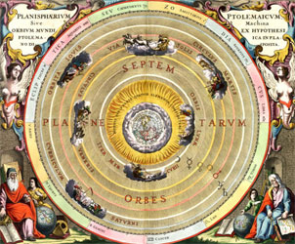
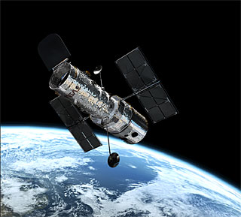
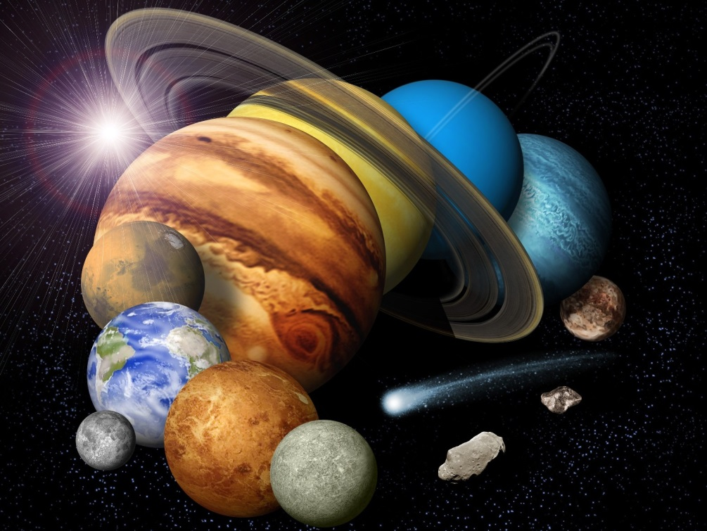
our universe
Our universe
We will be discussing:
History of Astronomy. (2014). Uploaded by the University of Sheffeld. Available online at:https://www.shef.ac.uk/physics/teaching/phy324
Our Solar System Montage. (2012). Uploaded by David Portree. Available online at: http://www.wired.com/2012/12/castles-in-space-1961-1971/our-solar-system-montage1/
About Hubble(2014). Uploaded by E.S.A. Available online at:http://www.spacetelescope.org/about/

Slide 12
our universe
Our universe
Part 4 Breakdown
27 Points –
8 points short answer
8 points venn diagram
11 points long answer

Slide 13
our universe
Our universe
Planets of the Solar System
The Big Bang Theory
Solar Nebula Theory
Meteor, Meteorite, Meteoroid
The Moon
Important Person, Tech, Mission
Important
concepts!!

